Slide 1
Snapshot
Vision and Actions on Jointly Promoting Agricultural Cooperation under the Belt and Road Initiative

Slide 2
Background
Ancient Silk Road Period
Agricultural trade and exchanges were major components of cooperation among countries along the route.
Exchanges of agricultural technologies and products were promoted and agricultural civilizations across the Eurasian and African continents communicated and carried forward.
Belt and Road Initiative in New Era
Agricultural cooperation is one of the converging points of efforts to build a community of common interests and a community of shared destiny.
It well reflects the common aspiration of countries along the route to eliminate hunger and poverty, ensure food security and nutrition, as well as jointly promote the integration and utilization of agricultural resources and further development of agricultural markets.

Slide 3

Significance
A top-level design of international agricultural cooperation under the Belt and Road initiative.
Vision and Actions on Jointly Promoting Agricultural Cooperation under the Belt and Road Initiative
The first proclamation that outlines agricultural development plans under the Belt and Road initiative.
Jointly Promoting Agricultural Cooperation
under the Belt and Road Initiative
·It is conducive to leveraging comparative advantages of countries and promoting orderly flow of agricultural factors, highly efficient allocation of agricultural resources and deep integration of agricultural markets in the region.
·It helps to shape a new pattern of international agricultural cooperation and promote mutually beneficial and win-win development among countries along the route.

Slide 4

Framework
Advocating the basic ideas of the Belt and Road initiative
Wide Consultation
Joint Contribution
Shared Benefits
Peace and Cooperation
Openness and Inclusiveness
Mutual Learning
Mutual Benefit

Slide 5
Upholding Five Principles
Policy Coordination
Market Operation
Government Service
Green and Sharing
Mutually Beneficial Cooperation
Shaping a new pattern of international agricultural cooperation
It envisions a community of shared interests, responsibility and destiny that focuses on implementing the five cooperation priorities and building the six economic corridors, primarily driven by exchanges and cooperation of agricultural science and technology. It also aims to build a wide channel for cooperation on competitive agricultural technologies and key agricultural products, shape a new pattern of international agricultural cooperation, and bring about a new phase of all-around two-way opening up with links running over land and sea.

Slide 6
Cooperation priorities
The Belt and Road Initiative cooperation highlights the connectivity of policy, infrastructure, trade, finance and people.
Five priorities of agricultural cooperation under the Belt and Road Initiative
Establishing agricultural policy dialogue platform
Establishing a three-in-one dialogue platform involving the participation of governments, research institutes and businesses of countries along the route, enhancing the synergy of their respective strategies and jointly mapping out plans and measures for agricultural development.
Strengthening agricultural S&T exchanges and cooperation
Improving agricultural trade cooperation
Expanding agricultural investment cooperation
Enhancing capacity building and people-to-people exchanges
Strengthening knowledge sharing and technological exchanges, and building the information service platform, technological advisory service system, high-end think tank and training bases with joint efforts.
Jointly building diversified and stable agricultural trade channels, furthering trade facilitation, increasing trade volume, expanding trade scope and enhancing agro-product quality and safety.
Upgrading multinational business cooperation, increasing investment along the whole industrial chain and encouraging two-way agricultural investment by countries along the route.
Providing vocational education and training for farmers, boosting business exchanges and cooperation in partner countries, building training bases collaboratively and promoting exchanges and mutual trust of people.

Slide 7

Future actions
Strengthening bilateral intergovernmental cooperation
Conducting multi-level and multi-channel communication and consultation, establishing high-level and regular agricultural cooperation mechanism and enhancing intergovernmental consultation on laws and regulations.
Reinforcing the role of multilateral cooperation mechanism
Capitalizing on existing agriculture-related multilateral mechanisms, deepening communication and cooperation with international organizations, and using international and regional development financial institutions to innovate financial services for international agricultural cooperation.
Giving full play to the role of major conferences and forums
Establishing the Belt and Road agricultural cooperation dialogue mechanism, agricultural planning and research communication platform, and agricultural resources, industry, technology and policy information sharing platform.
Improving cooperation mechanism

Slide 8
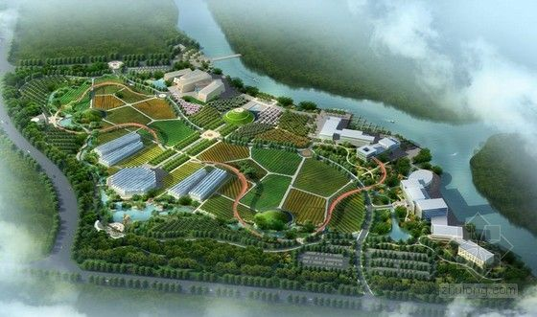
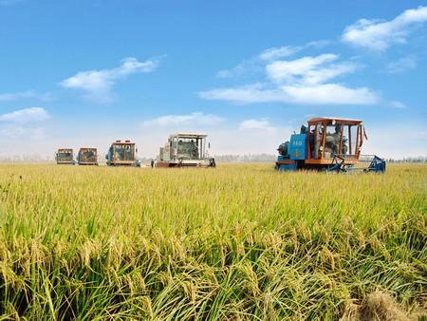
Agricultural opening-up and cooperation pilot zone
Overseas agricultural cooperation demonstration zone
Balancing domestic and foreign dynamics and pursuing two-wheel drive development
Establishing agricultural cooperation demonstration zones based on the willingness and conditions of countries along the route, fostering industrial clusters and leveraging the spill-over effect.
Two zones construction for international agricultural cooperation
Establishing agricultural opening-up and cooperation pilot zones in China's coastal, riverside and border areas with proper conditions, integrating resources and conditions for opening up.
Exploiting new carriers and models of the Belt and Road agricultural cooperation
Jointly planning and implementing seven major projects
Increasing regional comprehensive agricultural productivity
Agricultural S&T cooperation and demonstration
Joint prevention and control of animal and plant diseases
Promoting agricultural vertical integration
Improving trade infrastructure
Establishing comprehensive platforms for agricultural R&D and training
Developing agricultural information system

